Slide 1
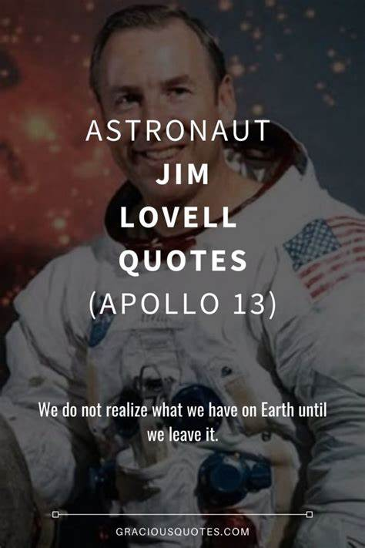
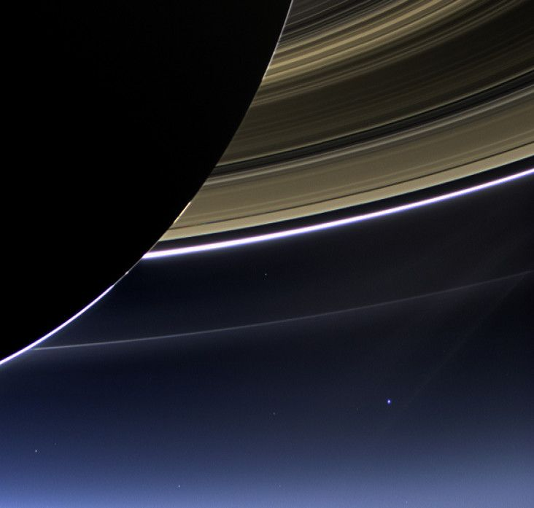
THE PLASMA ENVIRONMENT PART 2

Slide 2
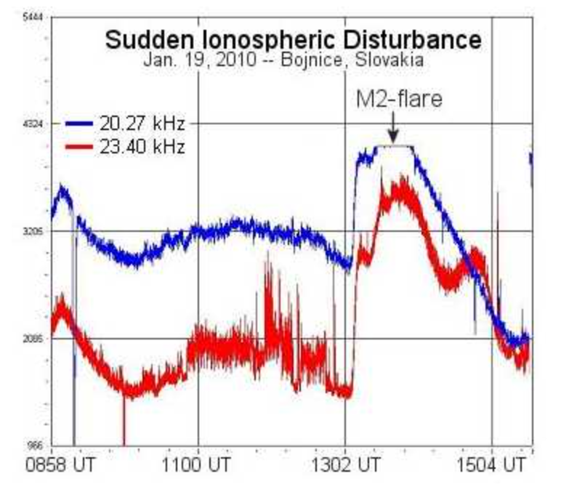
IONOSPHERIC DISTURBANCES
IONOSPHERIC STORMS
SUDDEN IONOSPHERIC DISTURBANCES
TRAVELING IONOSPHERIC DISTURBANCES
SPORADIC E REGION

Slide 3
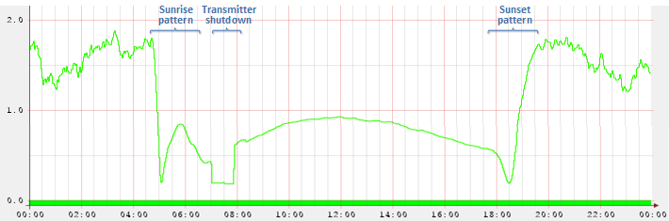
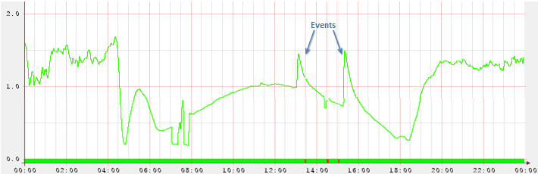
IONOSPHERIC DISTURBANCES

Slide 4
Medium-scale Traveling Ionospheric Disturbances (MSTIDs)
See GloTEC | NOAA / NWS Space Weather Prediction Center for more examples

Slide 5
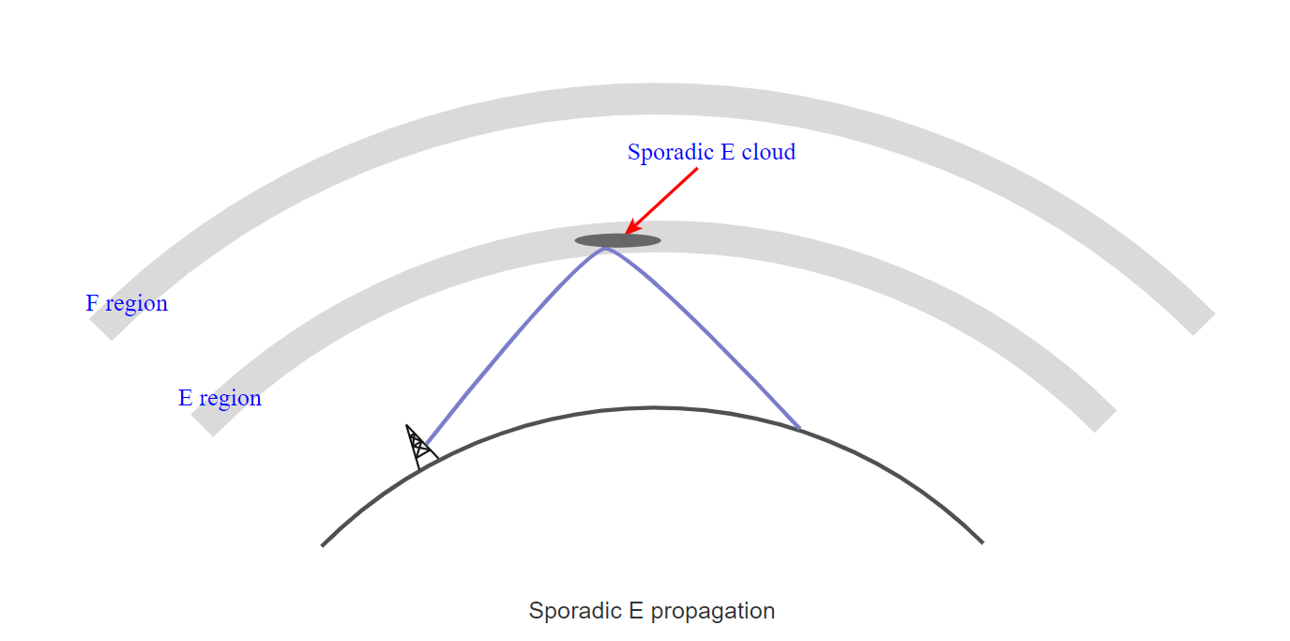

Slide 6
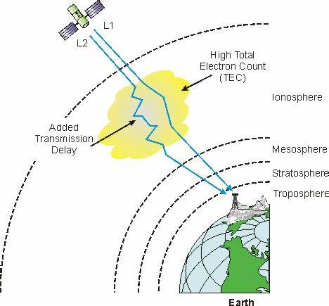
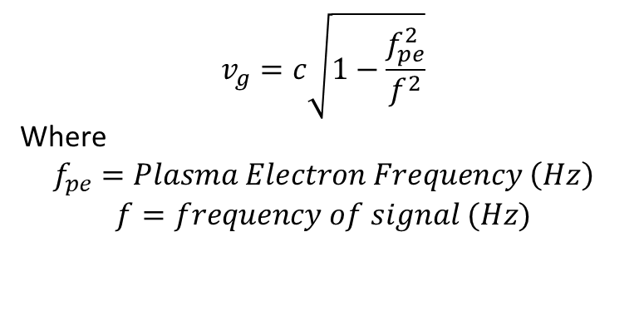
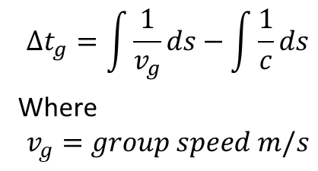
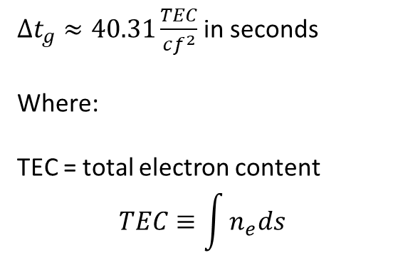
OTHER EFFECTS – Ionospheric Time Delay
$$∆t_{g}=\int{\frac{1}{v_{g}}ds−\int{\frac{1}{c}ds}}$$
Where
$$v_{g}=group speed m/s$$
$∆t_{g}≈40.31\frac{TEC}{cf^{2}}$ in seconds
Where:
TEC = total electron content
$$TEC≡\int{n_{e}ds}$$
$$v_{g}=c\sqrt{1−\frac{f_{pe}^{2}}{f^{2}}}$$
Where
$$f_{pe}=Plasma Electron Frequency \left(Hz\right)$$
$$f=frequency of signal (Hz)$$

Slide 7
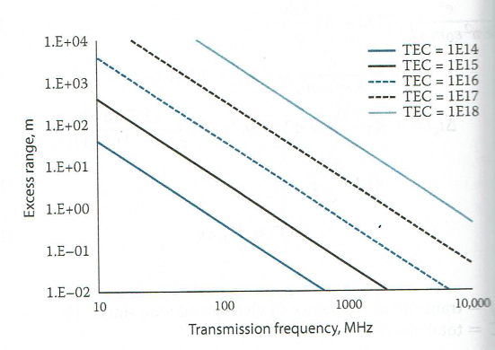
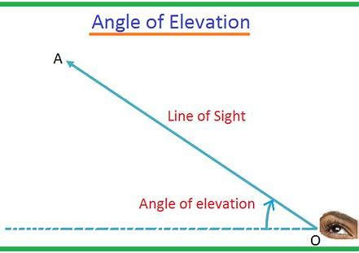

OTHER EFFECTS – EXCESS RANGE
$$∆r=c∆t_{g} \left(meters\right)$$
$$∆r=range error$$

Slide 8
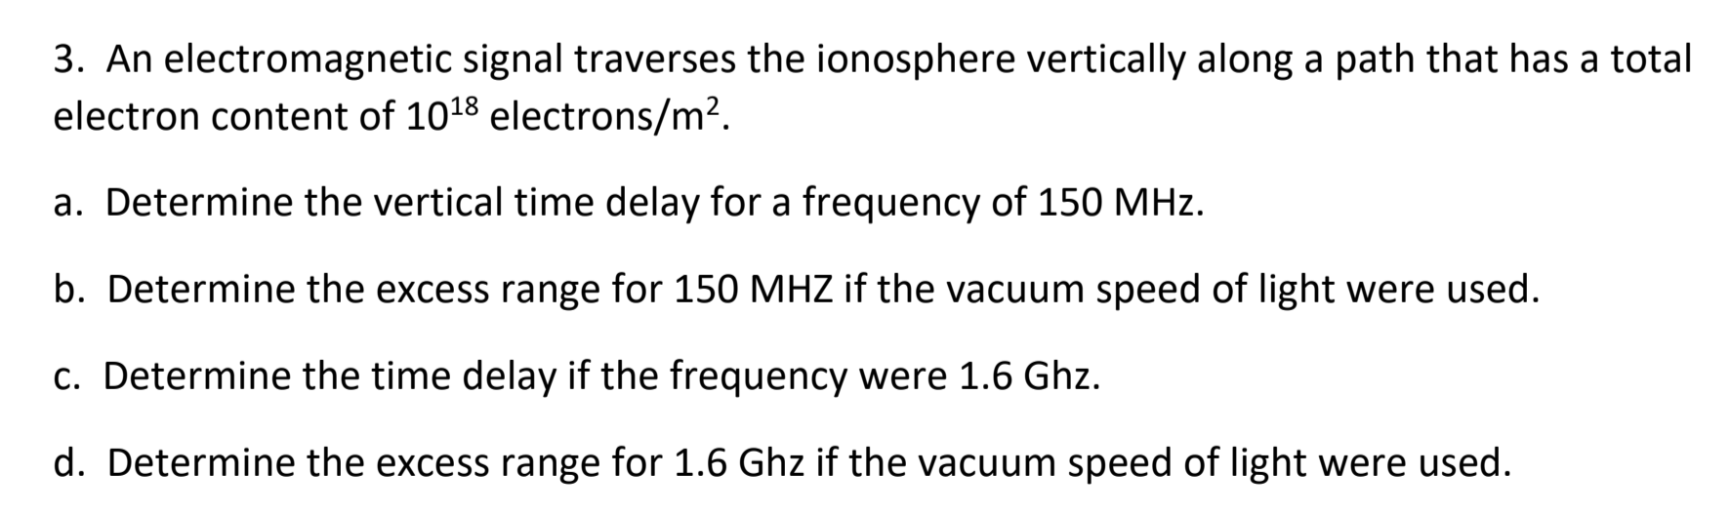

Slide 9
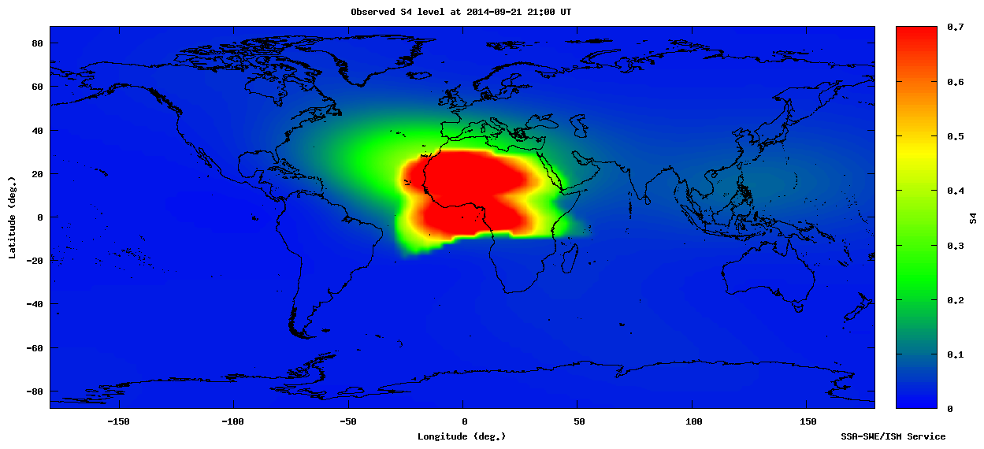
OTHER EFFECTS: SCINTILLATION
$$S_{4}=amplitude scintillation index$$
$$σ_{φ}=phase scintillation index$$

Slide 10
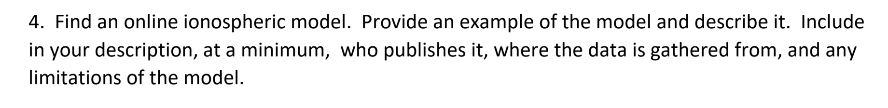

Slide 11
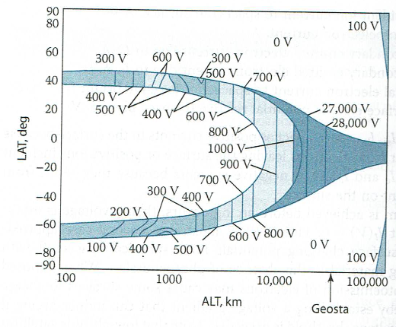
SPACECRAFT CHARGING
DARK = HIGH HAZARD
WHITE = LOW HAZARD

Slide 12

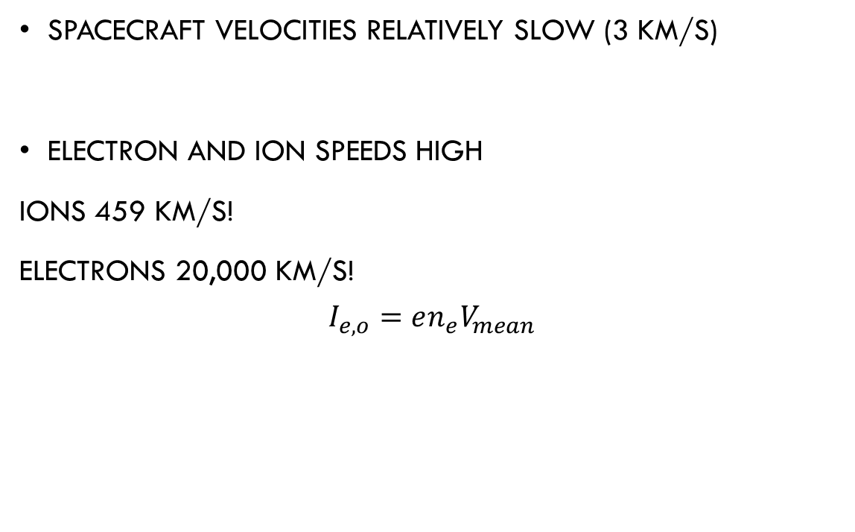
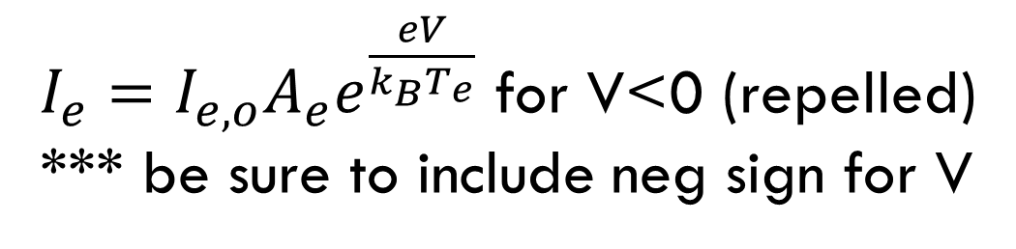
HIGH ALTITUDE SPACECRAFT
Spacecraft velocities relatively slow (3 km/s)
Electron and ion speeds high
Ions 459 km/s!
Electrons 20,000 km/s!
$$I_{e,o}=en_{e}V_{mean}$$
$$v_{mean}=\sqrt{\frac{8 k_{B}T_{i}}{πm_{i}}}$$
$I_{e}=I_{e,o}A_{e}e^{\frac{eV}{k_{B}T_{e}}}$ for V<0 (repelled)
*** be sure to include neg sign for V

Slide 13
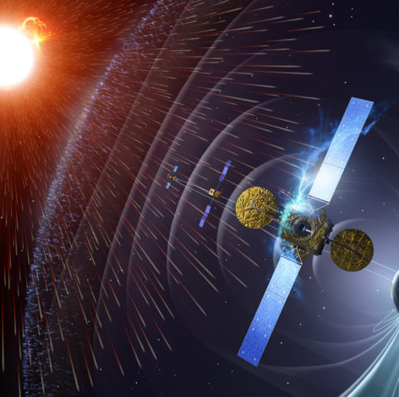
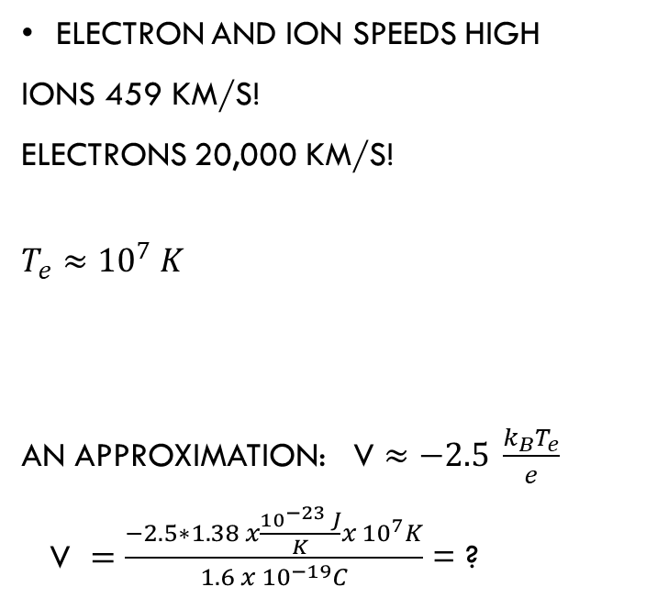
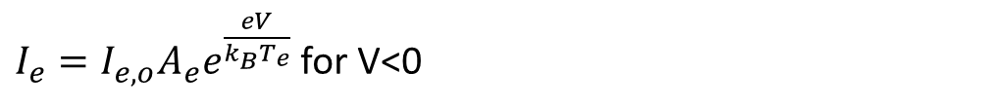
HIGH ALTITUDE SPACECRAFT
Electron and ion speeds high
Ions 459 km/s!
Electrons 20,000 km/s!
$$T_{e}≈{10}^{7} K$$
An approximation: V $≈−2.5 \frac{k_{B}T_{e}}{e}$
V $=\frac{−2.5∗1.38 x\frac{{10}^{−23 }J}{K}x {10}^{7}K}{1.6 x {10}^{−19}C}$ = ?
$I_{e}=I_{e,o}A_{e}e^{\frac{eV}{k_{B}T_{e}}}$ for V<0

Slide 14
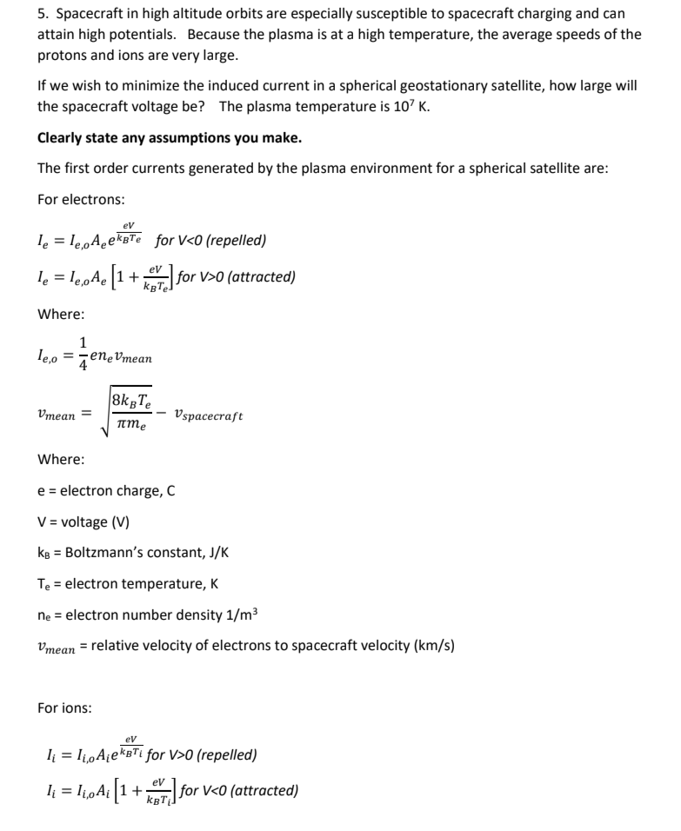
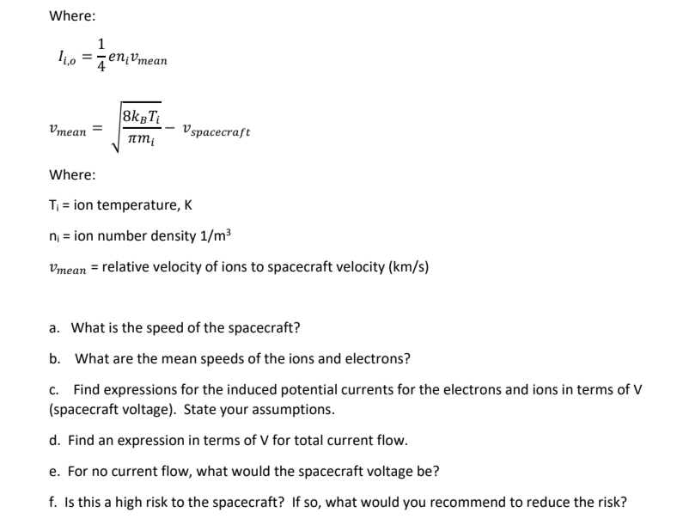

Slide 15
Example
A spherical spacecraft with a radius of 1 m is in the eclipse at an altitude of 1000 km. It has a bias voltage of -1.7625 V. The plasma temperature is a uniform 5000K and the plasma number density is 1.6 x 1011 m-3. Assume the resistivity of Kapton is 1526 Ω/cm. Also assume the density of electrons and protons is equal to the plasma number density.
Estimate the ion (hint O+ is the major component in that region) and electron currents.
How would you expect the voltage to change (worst case; i.e. pick whichever current is largest)?
Now the bias voltage is -1 V. Estimate the ion and electron currents (worst case; i.e. pick whichever current is largest)?
How would you expect the voltage to change? Is this more or less risky to the spacecraft?

Slide 16
Example
A spherical spacecraft with a radius of 1 m is in the eclipse at an altitude of 1000 km. It has a bias voltage of -1.7625 V. The plasma temperature is a uniform 5000K and the plasma number density is 1.6 x 1011 m-3. Assume the resistivity of Kapton is 1526 Ω/cm. Also assume the density of electrons and protons is equal to the plasma number density.
Estimate the ion (hint O+ is the major component in that region) and electron currents.

Slide 17
Example
A spherical spacecraft with a radius of 1 m is in the eclipse at an altitude of 1000 km. It has a bias voltage of -1.7625 V. The plasma temperature is a uniform 5000K and the plasma number density is 1.6 x 1011 m-3. Assume the resistivity of Kapton is 1526 Ω/cm. Also assume the density of electrons and protons is equal to the plasma number density.
Estimate the ion (hint O+ is the major component in that region) and electron currents.

Slide 18
Example
b. How would you expect the voltage to change (worst case; i.e. pick whichever current is largest)?
c. Now the bias voltage is -1 V. Estimate the ion and electron currents (worst case; i.e. pick whichever current is largest)?
D. How would you expect the voltage to change? Is this more or less risky to the spacecraft?

Slide 19
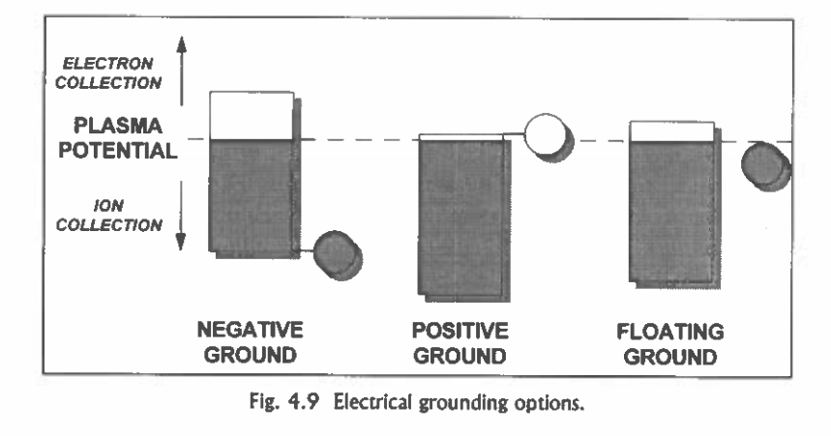
SPACECRAFT GROUNDING OPTIONS

Slide 20
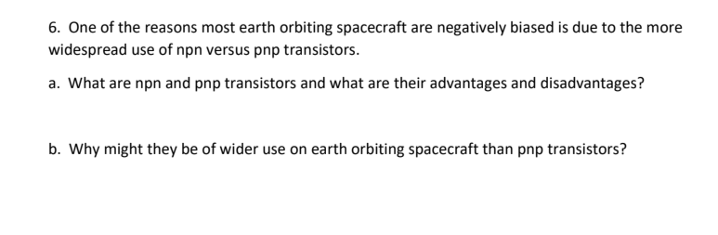

Slide 21
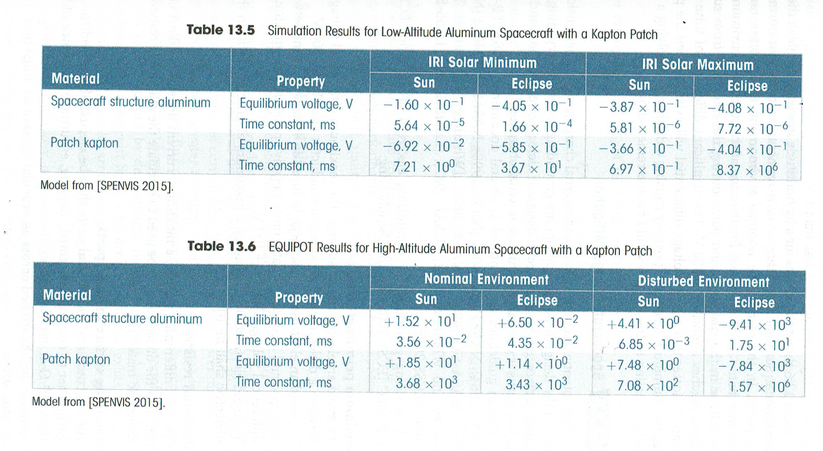
LOW AND HIGH ALTITUTE COMPARISON KAPTON PATCH

Slide 22
Guidelines to Minimize Degradation due to Plasma Effects
Prevent differential charging of surfaces by ensuring entire surface is of uniform conductivity
Prevent buildup of large potentials by actively balancing currents on spacecraft surfaces
Use surface coatings
Consider plasma contactors or plasma thrusters if problems are foreseen
Other preventive measures include:
Tying all conductive elements to a common ground
Shielding all electronics and wiring both physically and electrically
Using electric filtering to protect circuits from discharge of induced currents
Making all exterior surfaces at least partially conductive and thick enough to withstand dielectric breakdown
Notes:
Focus on preventing electrostatic discharges
Several techniques recommended by NASA
Make the exterior surfaces as conductive as possible
Minimize potential differences
Protect from discharge-induced currents
(ion)
Plasma generating device to “ground” the spacecraft to the plasma
⇒ used on space station (because arcing is expected due to thin thermal control coating)

Slide 23
Guidelines to Minimize Degradation due to Plasma Effects
Prevent differential charging of surfaces by ensuring entire surface is of uniform conductivity
Prevent buildup of large potentials by actively balancing currents on spacecraft surfaces
Use surface coatings
Consider plasma contactors or plasma thrusters if problems are foreseen
Other preventive measures include:
Tying all conductive elements to a common ground
Shielding all electronics and wiring both physically and electrically
Using electric filtering to protect circuits from discharge of induced currents
Making all exterior surfaces at least partially conductive and thick enough to withstand dielectric breakdown
Notes:
Focus on preventing electrostatic discharges
Several techniques recommended by NASA
Make the exterior surfaces as conductive as possible
Minimize potential differences
Protect from discharge-induced currents
(ion)
Plasma generating device to “ground” the spacecraft to the plasma
⇒ used on space station (because arcing is expected due to thin thermal control coating)

Slide 24
REFERENCES
Encyclopædia Britannica, inc. (n.d.). Physics and metaphysics of Aristotle. Encyclopædia Britannica. https://www.britannica.com/biography/Aristotle/Physics-and-metaphysics.
Illustration of the spacecraft charging process responsible for GOES-R operational anomalies. Graphic created by the author using ChatGPT (OpenAI), based on Rodriguez et al. (2024) and Horne et al. (2025).
Loudet, L. (11 June 2013). Ionosphere. Ionosphere and Sudden Ionospheric Disturbances. https://sidstation.loudet.org/ionosphere-en.xhtml#:~:text=A%20Sudden%20Ionospheric%20Disturbance%20results%20from%20an%20increased,increase%20the%20ionisation%20process%20and%20the%20electron%20density
NASA. (2021). NASA Jet Propulsion Laboratory California Institute of Technology. NASA. https://iono.jpl.nasa.gov/latest_rti_global.html
NASA. (2014). Near Miss: The Solar Superstorm of July 2012. NASA. https://science.nasa.gov/science-news/science-at-nasa/2014/23jul_superstorm/
NASA. (2019, December 10). 10 Things to Know About the Ionosphere – NASA Solar System Exploration. NASA. https://solarsystem.nasa.gov/news/1127/10-things-to-know-about-the-ionosphere/
Notes, E. (2021). Sporadic E, Es Propagation. Electronics Notes. https://www.electronics-notes.com/articles/antennas-propagation/ionospheric/sporadic-e-es.php#:~:text=Sporadic%20E%20basics%20Sporadic%20E%2C%20Es%2C%20arises%20when,when%20they%20would%20normally%20be%20at%20their%20highest
Sinha, A. (2020, December 3). Aristotelian Universe: the Earth-Centered Universe. Physics In My View. https://physicsinmyview.com/2020/08/model-of-aristotelian-universe.html.
Space solar cell edge, interconnect, and coverglass ... (n.d.).
https://www.researchgate.net/publication/224186897_Space_solar_cell_edge_interconnect_and_coverglass_designs_and_their_effect_on_spacecraft_charging_and_plasma_interactions.

